Slide 1
Mastering Go Programming
Mina Andrawos
Video 5.4
Pipelines: Build the Hydra chat system part 1

Slide 2
In this Video, we are going to take a look at…
The pipeline pattern
Write the Hydra chat room type
Write the Hydra chat client type

Slide 3
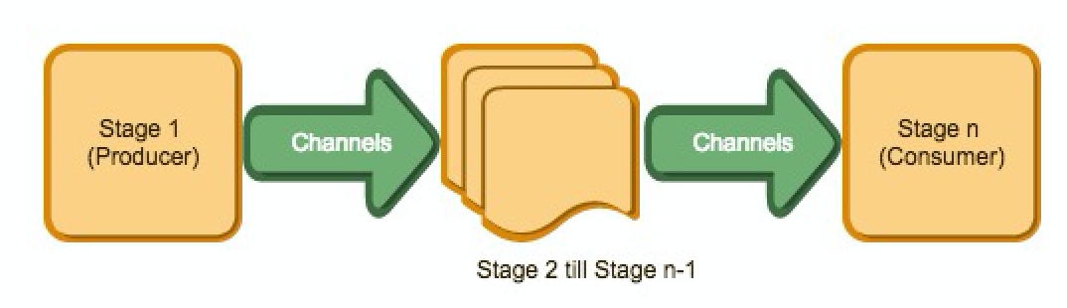
The pipeline pattern
https://blog.golang.org/pipelines
A concurrent pattern
A series of ‘stages’ connected by channels
Each stage is a group of goroutines running the same function

Slide 4
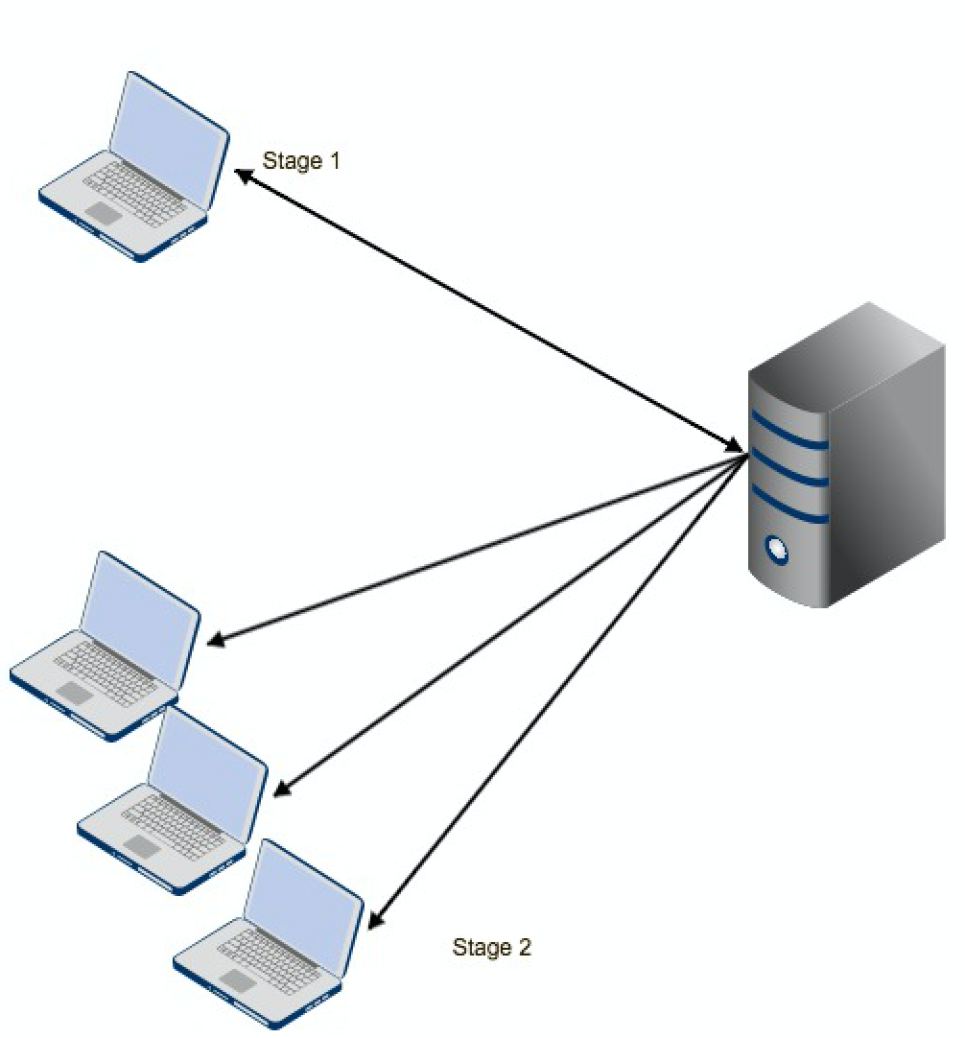
Hydra Chat system pipeline
One client sends a message to the chat server for a specific chat room
The chat server sends the same message to all clients in the same chat room

Slide 5
Pipelines in the chat application

Slide 6
Next Video
Pipelines: Build the Hydra chat system part 2

